Slide 1
Exploratory Analysis of New York City Yellow Taxi Data
- Venkatesh Subramaniam

Slide 2
Introduction
The New York City Taxi & Limousine Commission has released a staggeringly detailed historical dataset covering over 1.1 billion individual taxi trips in the city from January 2009 through June 2015.

Slide 3
Bottle Neck during the process
Humongous tables – 77,080,575 taxi trips in the year 2015 – clogged my bandwidth, hogged my RAM, and stymied my efforts. So I chose to reduce my scope and explored on a small scale of data. So , I chose January 2015 data but still it was 1.8GB .
Overcoming the bottleneck: I deleted few columns and used package(ff) which helped the process of importing data into R.

Slide 4
Why Exploratory Analysis
Exploratory Data Analysis (EDA) is an approach to analyzing data. It’s where the researcher takes a bird’s eye view of the data and tries to make some sense of it.

Slide 5
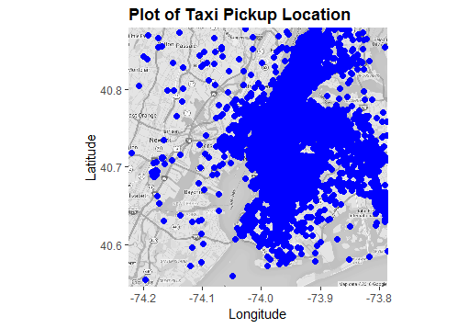
NYC Taxi Pick Up Locations

Slide 6
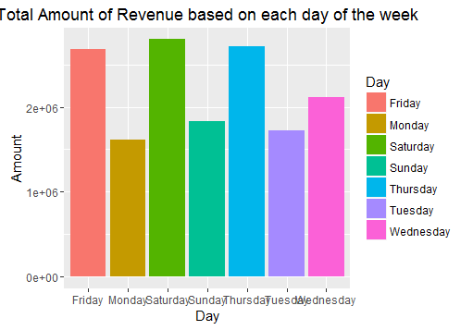
Plot of the Total Revenue across the week

Slide 7
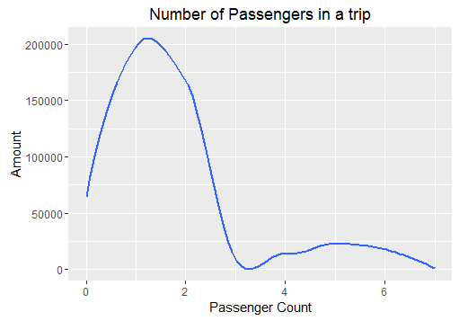
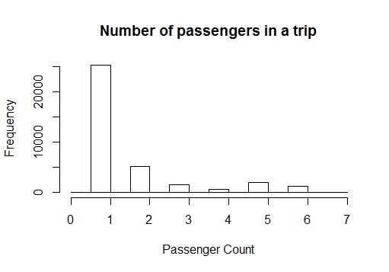
Plot of Number of Passengers in a trip

Slide 8
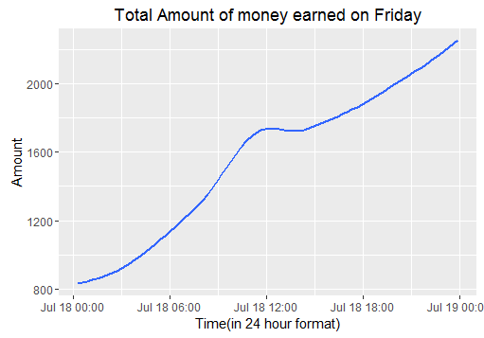
Plot of Total amount of money earned on Friday

Slide 9
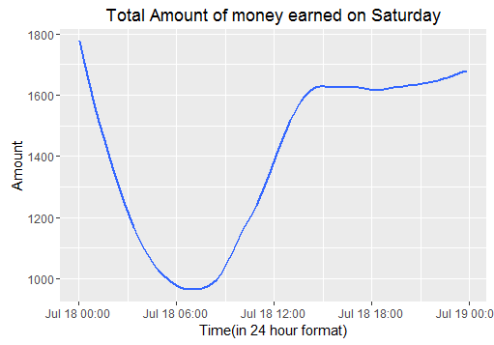
Plot of Total amount of money earned on Saturday

Slide 10
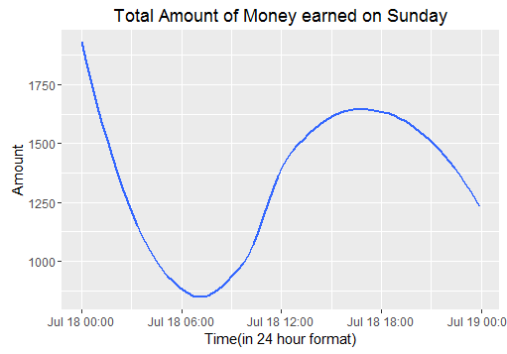
Plot of Total amount of money earned on Sunday

Slide 11
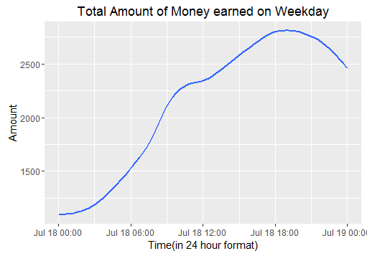
Plot of Total amount of money earned on Weekday

Slide 12
Key Insight obtained from the plots
The following questions can be answered from the plot
How much can the industry expect to earn from a day
How the number of customers changes from start to the end of the day
How to plan the work schedule so that the driver works in best possible time and day and increase the his profit considerably

Slide 13
Future Scope
Find the best and worst location to get customers at given time and day of the month
Analyze the location where people most likely go when boarding the taxi depending on their pickup location.
A model can be designed for increasing the growth of the companies in this field by making them spend their resources and money wisely

Slide 14
Thank You

